Slide 1

MoneyFi: Your Smart Financial Tracker
Take control of your finances with MoneyFi's intuitive budget tracking, insightful analytics, and AI-powered guidance.
- By
Kodi Bharadwaj
Vignay Bandari

Slide 2
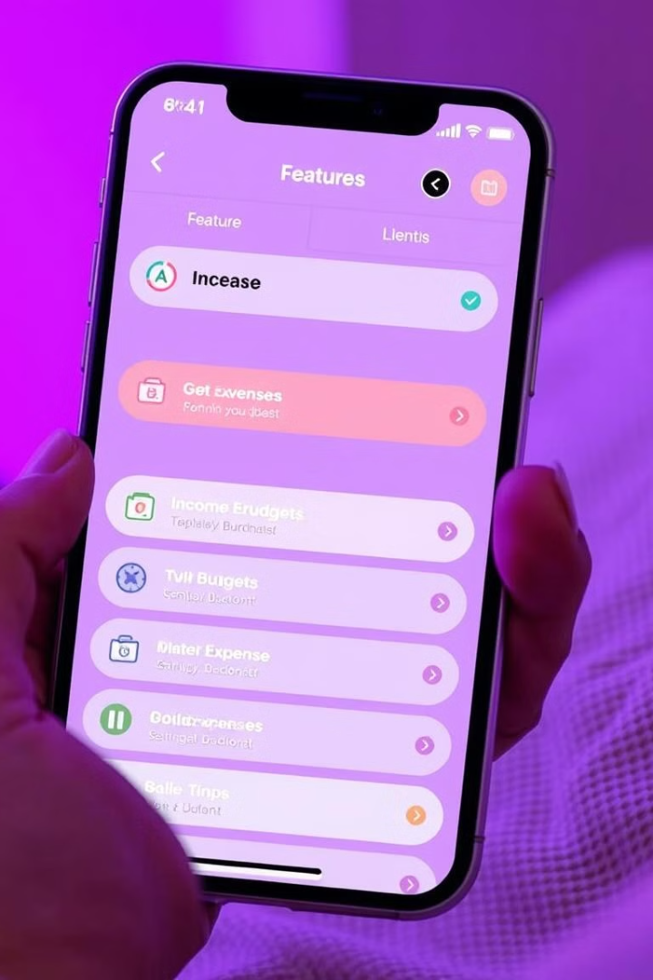

Features for Every Financial Journey
1
Income Management
2
Expense Tracking
Add and Track income sources, filter by month and year
Categorize expenses, filter by month and year
3
Budgeting
4
Goal Setting
Set monthly limits, track progress, and stay on track
Define savings goals, visualize progress towards milestones

Slide 3
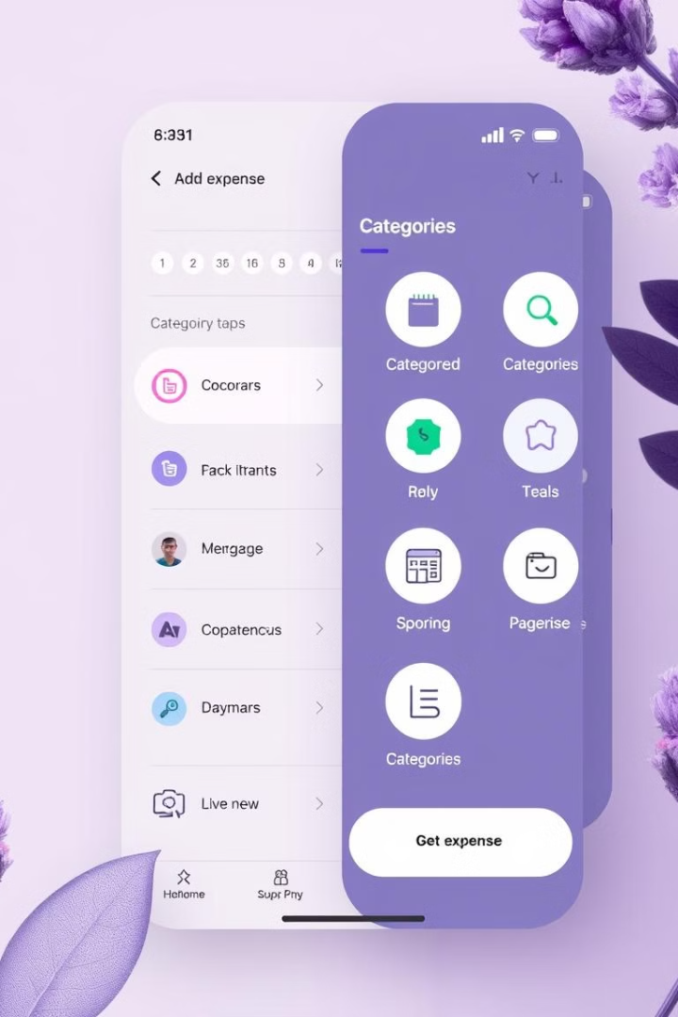
Expenses: Organized Control
Categorization
Visual Insights
Easily categorize and track spending
Monitor spending patterns, identify areas for optimization
Filter Options
Analyze spending trends by monthly and yearly periods

Slide 4
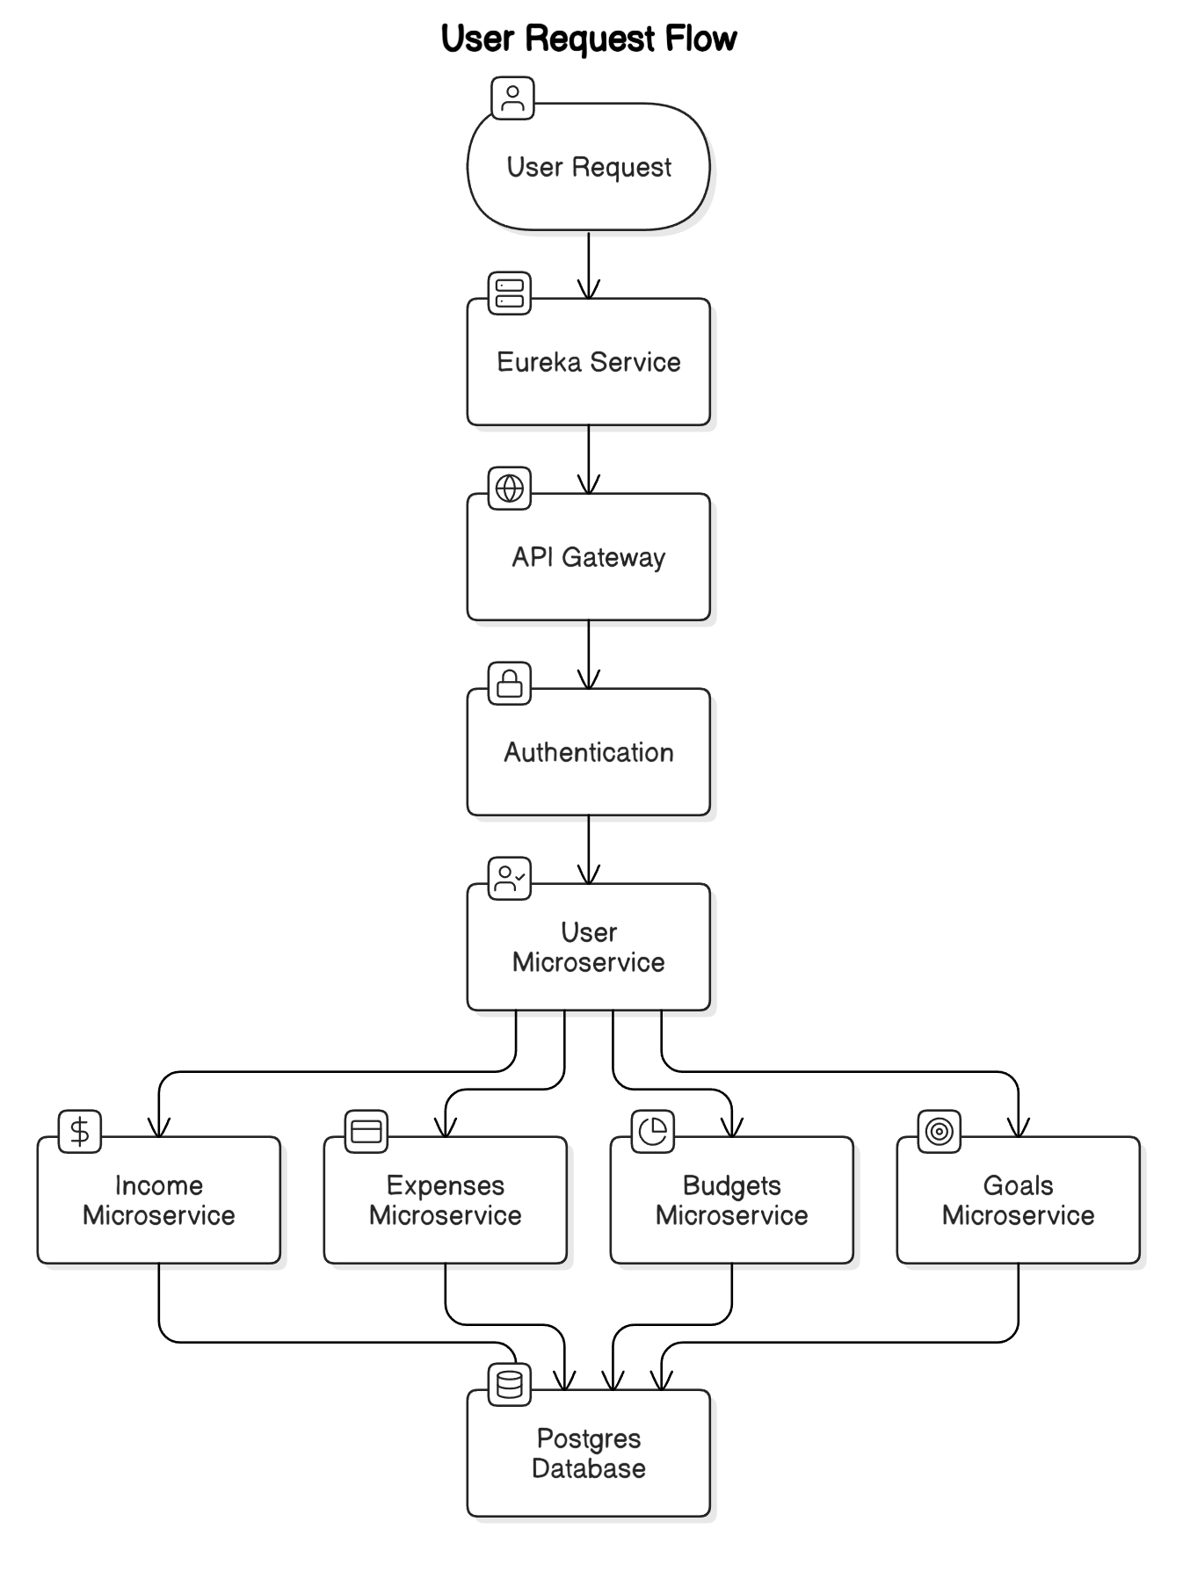
Angular
Modern front-end framework
Java with Spring
Robust and scalable backend
PostgreSQL
Reliable and secure database
JWT Authentication
Secure user authentication

Slide 5

Unlocking Your Financial Potential
MoneyFi helps you achieve your financial goals through data-driven insights and a personalized experience.

Slide 6
Future Enhancements:
To build Mobile application for easy access.
To implement Google authentication (OAuth).

Slide 7
Thank You

